Slide 1
ReactJS Application for Chatbot
PREPARED BY:
TONY VARGHESE

Slide 2
INTRODUCTION
Objective : To develop a chatbot interface that allows users to:
List and select clients.
Select modules for response generation.
Display responses in a tabular format with pagination.
Scope:
Provide an interactive, user-friendly frontend using ReactJS.
Ensure robust backend functionality using FastAPI.

Slide 3
Key Features
List down the main features of the application:
Client Selection (e.g., Amgen, GSK).
Module Selection (e.g., Customer, Medicaid, T-Bill Rates).
Response Generation in a Tabular Format:
Includes fields: Process Area, Requirement ID, Requirement Description.
Pagination for easy navigation.
API integration between ReactJS and FastAPI.

Slide 4
Technology Stack
Frontend: ReactJS, React Bootstrap, HTML, CSS
Backend: FastAPI
Database: MySQL
Tools:
Git (Version Control)
Postman (API Testing)
Swagger (API Documentation)
GitHub (Code Repository)
VS Code (IDE)

Slide 5
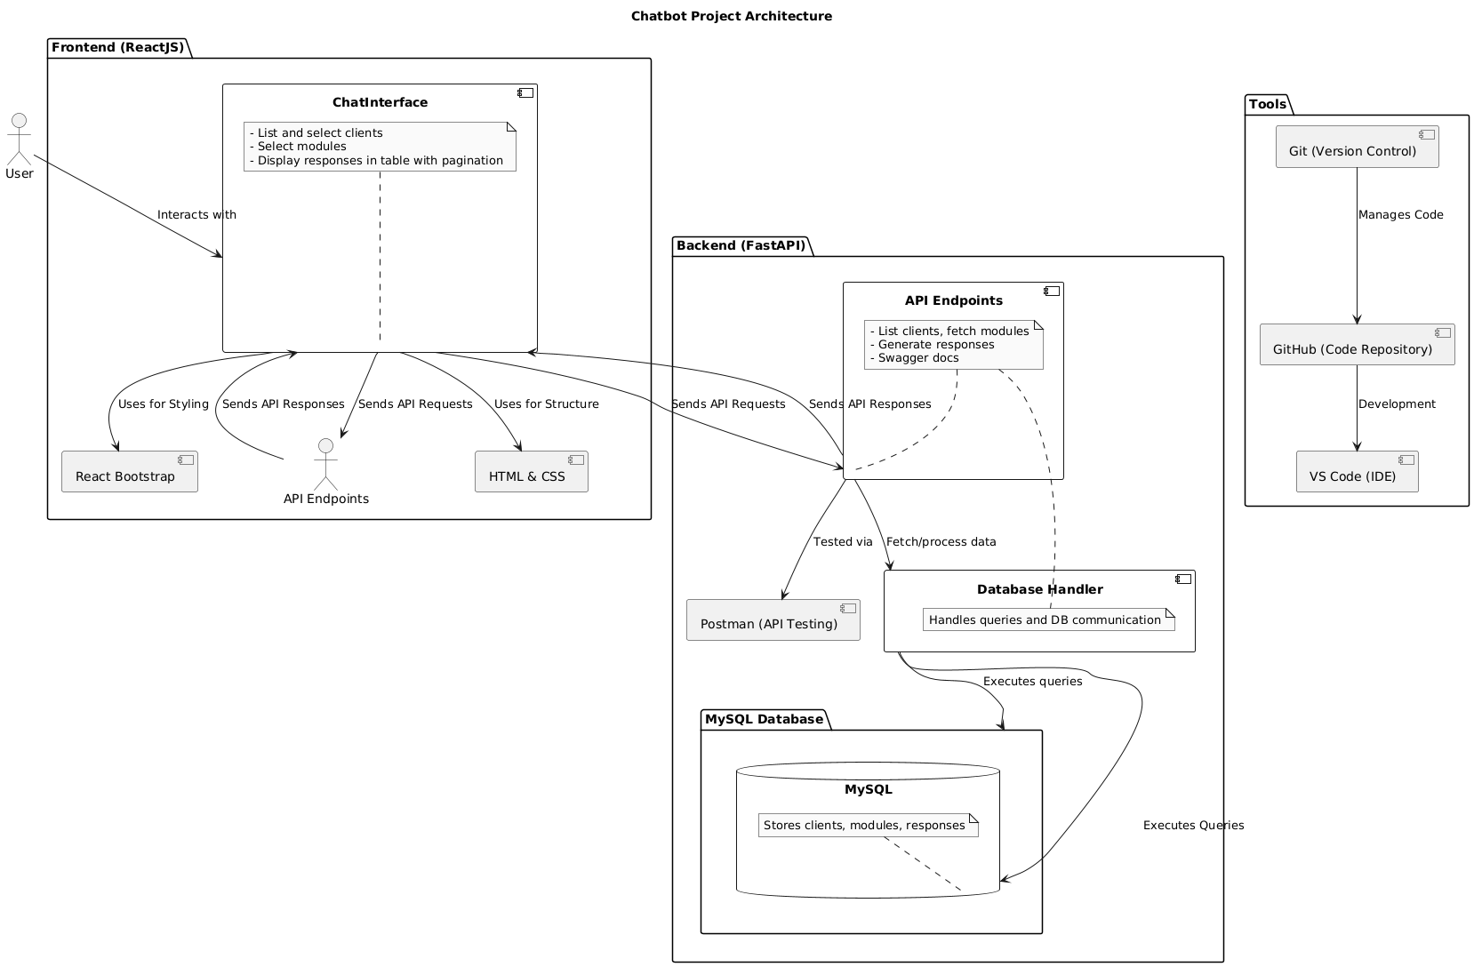

Slide 6
Thank You

